Slide 1
Data Visualization Methods for Scientific Careers
Kyeongan (Karl) Kwon
PhD Proposal
Advisor: Prof. Ioannis Pavlidis
Feb 2016
Notes:
Hello everyone, Thank you for coming today for my PhD proposal. My name is Kyeongan and I go by Karl. Today, I am going to present my research about ‘data visualization methods for scientific careers’
Before starting my presentation

Slide 2
Exploration vs Explanation
Visualization for exploration, When you don’t (yet) have a story to tell.
Visualization for explanation, when you have a story to tell.

Slide 3
Education vs Persuasion

Slide 4
Overview
Introduction
Data Visualization
Design and Methodology
Demo
Research Challenges
Different types of data, different formats, different resources
No APIs provided (Google Scholar)
References
Conclusion and Future Work
Acknowledgment

Slide 5
What is Data Visualization?
Data visualization is the presentation of data in a pictorial or graphical format. It enables decision makers to see analytics presented visually, so they can grasp difficult concepts or identify new patterns.
A
B
Notes:
Before start to present my research, I would like to talk about a little bit what data visualization is exactly.
Data visualization is the graphical display of abstract information for two purposes: sense-making (also called data analysis) and communication.
visual face.

Slide 6
Why Data Visualization Matters?
Because of the way the human brain processes information, using charts or graphs to visualize large amounts of complex data is easier than poring over spreadsheets or reports. It is a quick, easy way to convey concepts in a universal manner.
Visualization makes data accessible
Quickly notice something out of position, patterns and pattern violations
Visualization gives faster access to actionable insights
Visualization allows access to huge amounts of data
Notes:
Because of the way the human brain processes information, using charts or graphs to visualize large amounts of complex data is easier than poring over spreadsheets or reports.
Data visualization is a quick, easy way to convey concepts in a universal manner – and you can experiment with different scenarios by making slight adjustments.
(trends, gaps, outliers)

Slide 7
Data Visualization vs. Infographics
O
Data Visualization – by software
Infographics – by hand
X
Notes:
I would like to point out the difference between Data visualization and Infographics because many people are confused these two terms. Data Visualizations are far more likely to be generated automatically through the use of algorithms or computer programs. Infographics are manually drawn by Designers through the use of illiust

Slide 8
Introduction
Motivation
Prior works
What is the problem I am studying?
Why is it important?
What results have you achieved?

Slide 9
Figures:
ER diagram – reverse engineer on WorkBench
PiWiki - Log
Visualization and Quantitative Analysis for subject and academic careers.
Justification : Usefulness,

Slide 10
Introduction
A curriculum vitae (CV)
Tend to provide great detail about academic and research experiences
Difficulty and time consuming to analyze academic CVs.
Graduate students in search of a PhD advisor
Aspiring faculty in search of a fitting department
Reviewers in a funding agency accessing a proposer’s record
What methods that solve these issues.
Data Science / Analytics / Visualization
Notes:
Typically, CVs are used in academic positions, where your publishing and research history as well as your memberships and fellowships are important parts of your background.
It is relatively difficult and time consuming to thoroughly analyze academic CVs.
Graduate students in search of a Ph.D. advisor
Aspiring faculty in search of a fitting department
Reviewers in a funding agency assessing a proposer’s record
So we came up the idea how we can solve this problem.
One thing we can approach is Data science. More specially, data visualization is right method for this purpose.

Slide 11
Problem
Appraising academic careers
Hiring faculty
Promotion and Tenure
Peer-reviewing
Matching student to advisor
Open Problem CV
Length
Often convoluted
With potential errors / misses
Inconsistent

Slide 12
(Topic and )Purpose
The best data visualizations are ones that expose something new about the underlying patterns and relationships contained within the data.
Something new: Scholar Plot / Scholar Compare / Group Plot

Slide 13
Visualization Research
How does it work usually?
Understanding data sources can help.
Where data come from
Put successful story
74% improved accuracy and performance

Slide 14
Data format and Data retrieval
JSON format and how to draw it in d3
Scholar Python
HtmlSQL in PHP
Computational representation – how good/ why it is good

Slide 15
Goals of Research, Motivation
Understand how people use visualizations to gain insight
Design principles and techniques for effective visual analysis systems
Visualizations techniques
Visualizations tools

Slide 16
Potential significance
Potential Significance

Slide 17
Related work
Google Scholar
Free
All inclusive
Only publications
Scopus
ORCID

Slide 18
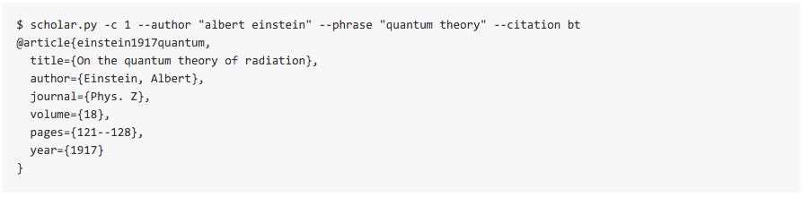
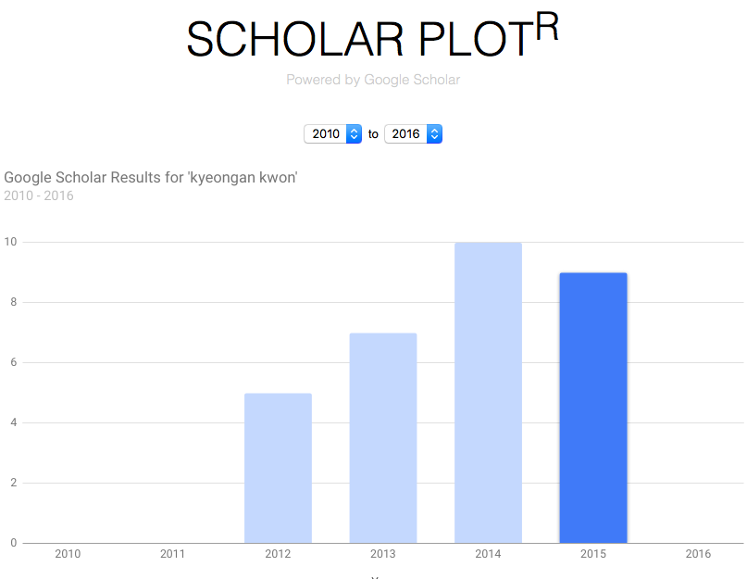
Related work
scholar.py - A parser for Google Scholar, written in Python
Scholar Plot^{R -} Plot Google Scholar search result frequency by year

Slide 19
What is missing
Summary Interface
No articulating philosophy about academic merit
Scholar Plot fills the gap
Visual summary
Solid scheme for academic merit

Slide 20
Design and Methodology
Notes:
In this section, I would like to talk about the design and methodology of scholar plot.

Slide 21
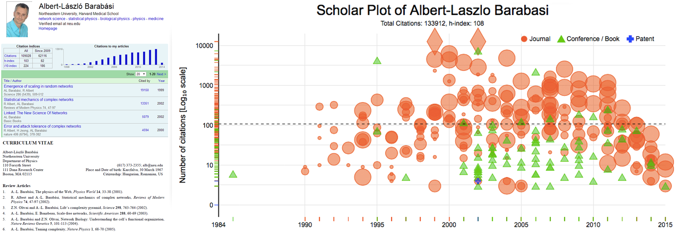
Design and Methodology
A: Google Scholar Profile
C. Scholar Plot
B: Curriculum Vitae
Notes:
I have three figures of the same scholar in order to see the difference.
Google Scholar Profile. It is the most inclusively data
Curriculum Vitae, a brief account of a person's education, qualifications, and previous experience. It is still very popular. However, user needs to make themselves as PDF and always need to update it whenever new publications apperared.
Here, I want to ask you what these are missing?
- One when is the first and least publication they are publicshed.
– Another is you have no idea that
Quick comparison Google Scholar, Curriculum Vitae and SP
scientfic evidenace / crucial factors / justify why it is being considered.

Slide 22
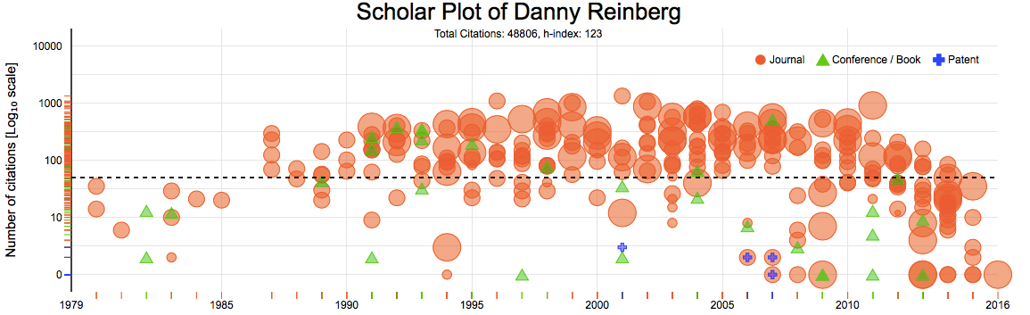
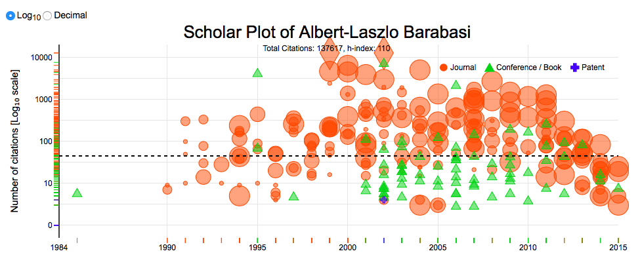
Design and Methodology
Notes:
(Details as much as possible)
This is one result of a scholar who have about 300 publications includes all Journal/ Conference and Patents.
I am sure that most of people includes you understand this visual results tell
It is easy to identify what type of publication powers the individual’s scholarship - a correlate of disciplinary culture. For example, it is easy to spot career profiles of computer scientists and engineers, where typically scholarship is built on conference rather than journal publications.

Slide 23
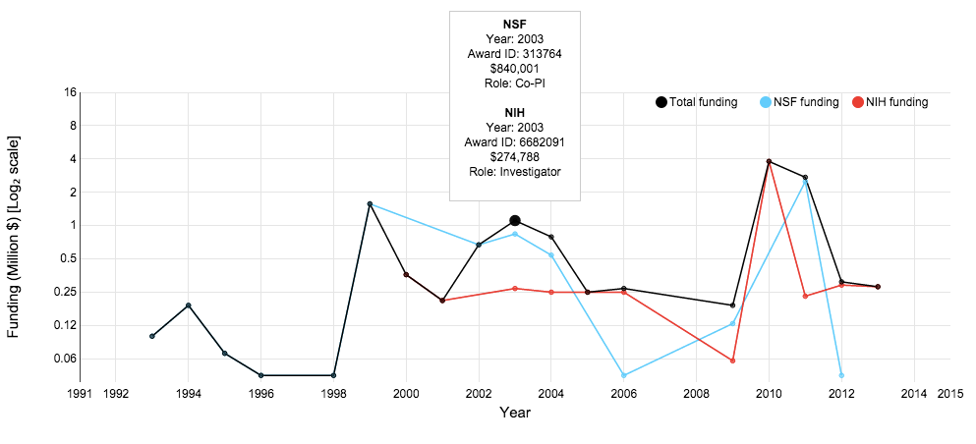
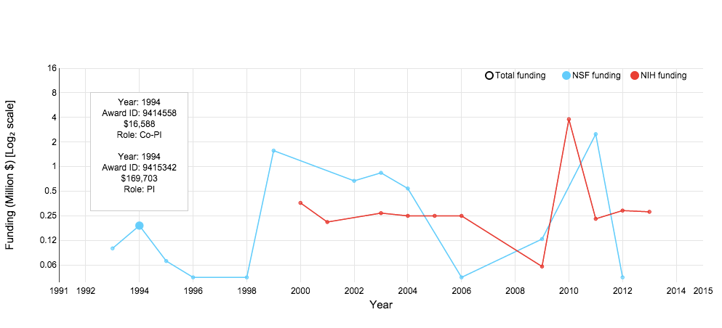
Design and Methodology
Funding results of NSF, NIH, NASA data
NSF: FY 1985 - FY 2013 (29 years, 312,311 rows, 10,769/year)
NIH: FY 2000 - FY 2013 (14 years, 777,657 rows, 55,456/year)
NASA: FY 2007 - FY 2015 (9 years, 16,670 rows, 1,852/year)
Tooltip displays
Agents, Year, Award ID, Amount and Roles such as PI, Co-PI, Investigator
Notes:
Scholar Plot also depicts the NSF/NIH/NASA funding of an individual as a multiline in log₂ scale

Slide 24
Focus group feedbacks
Feedbacks from social scientists at Northwestern University.
Added four different panel section
Co-Authors
Journals Ranked by Frequency
Top 5 Most Cited Papers
Top 5 Journals by Impact Factor
Notes:
Initial feedback through a focus group, we’ve added 4 panels below scholar plot results.
It consists of 4 panels.
Interface team science information. Participants wanted to see the number and intensity of collaborations for the depicted scholar.
Summarize highly cited papers. Participants wanted to see explicitly in a side panel the scholar’s most popular papers.
Interface journal profile. Participants wanted to see the specific journals where the scholar publishes most often and their impact factors.

Slide 25
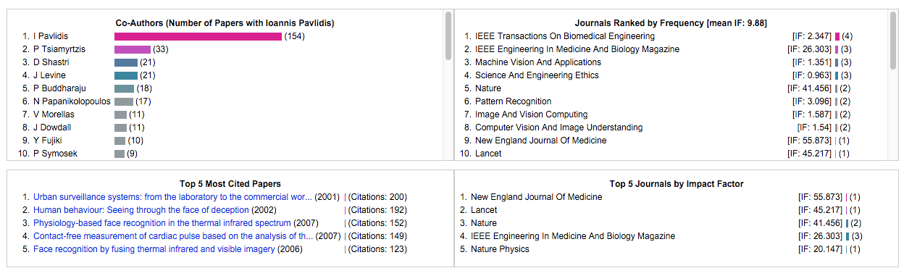
Design and Methodology
Four ancillary panels
Notes:
Top left is Co-Authors
This is very useful information it summarizes the scholar’s top collaborators. Just super quick you know.
Have up to 30, but display top 10 you can see without scrolling.
Top right is Journals Ranked by Frequency
Bottle left is Top 5 Most Cited Papers
Bottle right is Top 5 Journal by Impact Factor
These insights are not easily available from the CV or Google Scholar page4

Slide 26
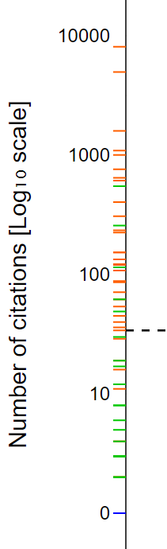
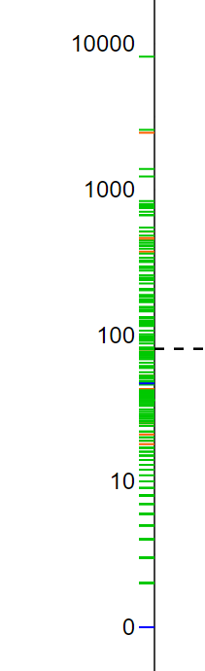
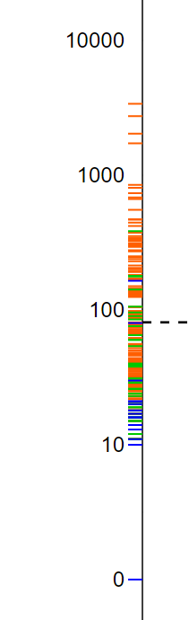
Design and Methodology
Vertical Distribution
A: Some Conference and Journal Papers
B: Focused on Conference Papers
C: Journals and Some Patents
Why this is useful?
You can see and tell their stories briefly.
A
B
C

Slide 27
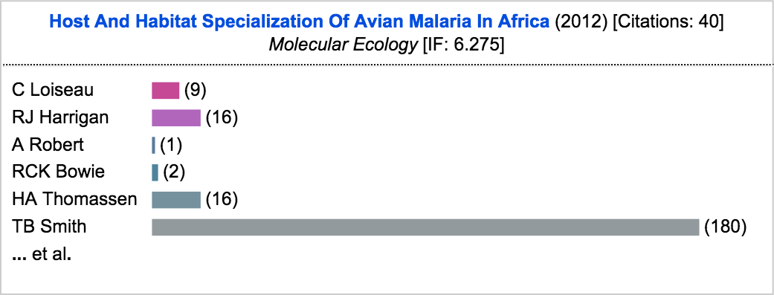
Design and Methodology
Tooltip interacting with details
Title, Year of Publication, Citation number, Journal [Conference, Patent] name and Impact Factor value
Co-Author list by order and the horizontal visual bars to tell how many times each author has been collaborated.
Notes:
We have another feature that interact an each plot.
When you interact with a plot, it shows the tooltip, which includes paper title, year of publication, the number of citations, journal or conference name and journal impact factor.
this is optional

Slide 28
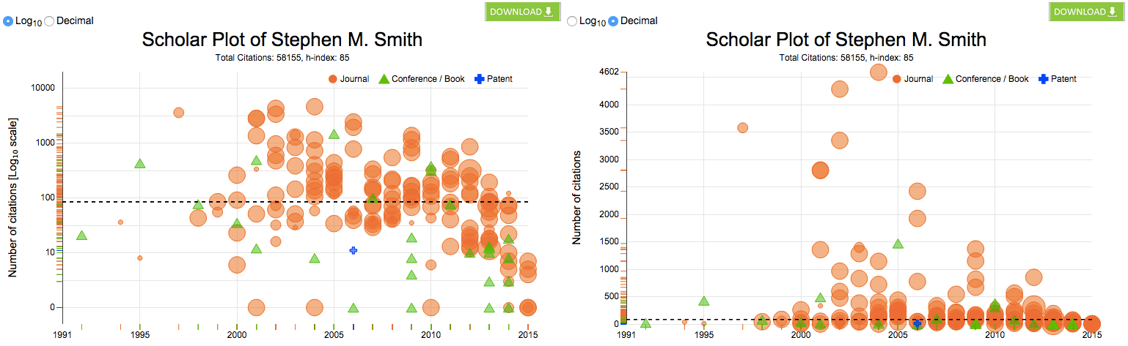
Design and Methodology
Scale Views to create a standardized scale for the y-axis for comparison
Log₁₀ (Default)
Decimal
Notes:
Individual SP publication plot has two different scales views to create a standardized scale for the y-axis for comparison, we introduced a log10 scale for the default plot and an option to toggle to the decimal scale view.

Slide 29
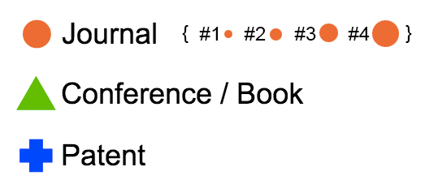
Design and Methodology
Publication symbols
Journal (A ~ r²)
Conference / Book
Patent
Journal sizes
IF bracket ( IF < 2) - #1
IF bracket (2 ≤ IF < 4) - #2
IF bracket (4 ≤ IF < 16) - #3
IF bracket (IF ≥ 16) - #4
Notes:
I want to talk to publication symbols and its size.
Only journal publications have a widely accepted ranking system that is the Journal Impact Factor (IF) List.
So, we represent different publication types with different symbols, varying the symbol size of journal publications only, for which an established ranking system exists.
- We chose disks to be the symbols of journal publications, as disk scaling can be done very effectively by simply varying its radius (A ∼ r2).
Specifically, after performing histogram analysis on the IFs of journal publications, we settled on four disk sizes to represent journal prestige: #1 < #2 < #3 < #4 (Fig. 2). We found that the great majority of journal publications appear in journals with IF < 2, assigning to this cohort the smallest disk size symbol, #1. These are mid- level specialized technical and scientific journals.
The next IF bracket (2 ≤ IF < 4) includes high quality specialized technical (e.g., IEEE Transactions) and scientific journals represented by disk #2.
The third IF bracket (4 ≤ IF < 16) includes very high quality science journals and specialized medical journals represented by disk #3.
The top IF bracket (IF ≥ 16) includes famous general science journals (e.g., Nature) and top medical journals (e.g., New England Jour- nal of Medicine); they are assigned the largest disk, #4.

Slide 30
Demo
Scholar Plot
Notes:
5-8 mins

Slide 31
Data collection methods
Scholar Data
Collection
Clean
Funding and Impact Factor Data
Download, Search
Extract and parse using xmlstarlet
Design RDMBS (MySQL)
Notes:
Scholar’s publication data is at from Google Scholar Profile and publication data. I used the

Slide 32
Data collection methods
NSF: FY 1985 - FY 2013 (29 years, 312,311 rows, 10,769/year)
NIH: FY 2000 - FY 2013 (14 years, 777,657 rows, 55,456/year)
NASA: FY 2007 - FY 2015 (9 years, 16,670 rows, 1,852/year)
Where to download, How to clean, What to have

Slide 33
Name Disambiguation
Google Scholar includes many different cases on its page of papers
Ioannis T Pavlidis
IT Pavlidis
I Pavlidis
Ioannis Pavlidis

Slide 34
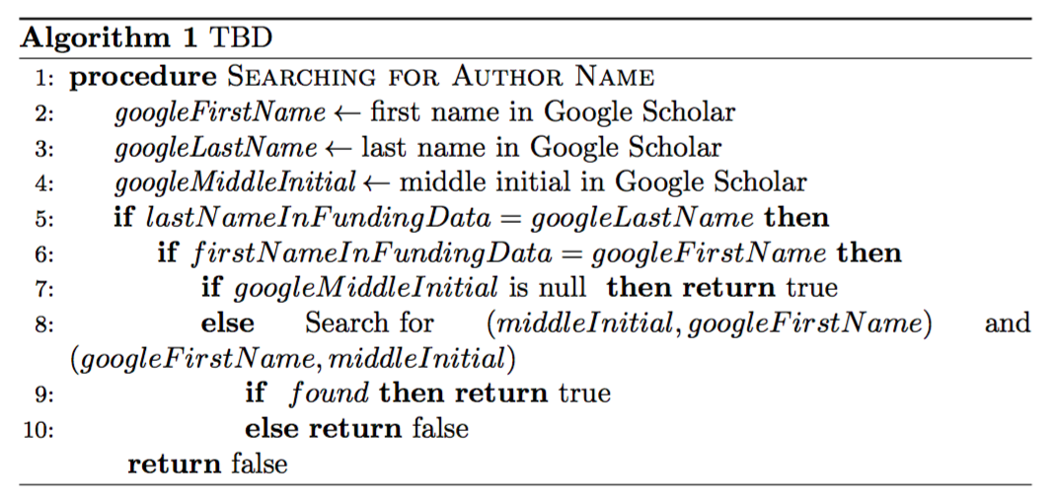
Name Disambiguation
The algorithm applied to the system to match funding data

Slide 35
System Architecture
Notes:
(30 secs – 1 min)
I do not go through the system. However, I myself want to mention because this system is built very well and took lots of efforts to have it. Frontend Development, MySql Databse, Many Datbase programming, Scrapping information from Google by avoiding blocking. I can’t list all but we even blocked morn than 10 times. We had have ‘sleepless night’

Slide 36
Entity Relationship (ER) Diagrams
Two Different ER diagram
Funding
JCR

Slide 37
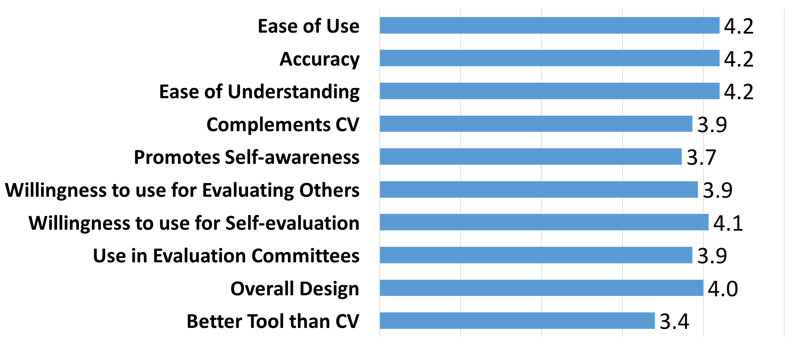
Usability Study
Participant (n=15) including Graduate, Post Doc, and Faculty
From various natural, mathematical, and social sciences.
Likert scale from 1 to 5, with 1 being strongly disagree and 5 begin strongly agree
Overall, it is a user friendly tool that academic users find of interest and value.
Notes:
A total of n = 15 participants from various natural, mathematical, and social sciences participated in the user study, which was approved by the Institutional Review Board (IRB) of the University of Houston.
We asked each participant to review and interact with the SP interface before completing an online survey.
The participants answered 10 questions on a Likert scale from 1 to 5, with 1 being strongly disagree and 5 being strongly agree.
Usability, accuracy and intuitive understanding of SP scored the highest (μ = 4.2).
Another key result is that the participants were planning to use SP frequently (μ = 4.1).
Overall, the survey confirmed that the base level of SP is a user- friendly tool that academic users find of interest and value.

Slide 38
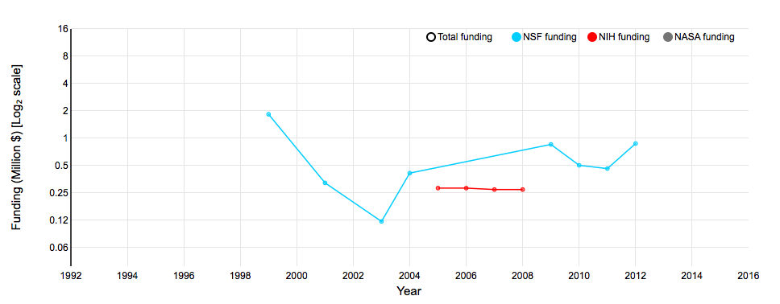
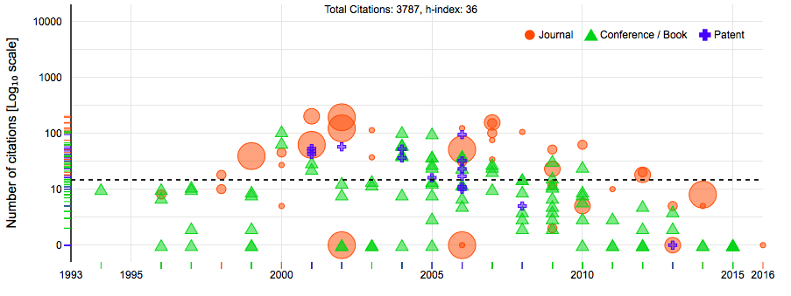
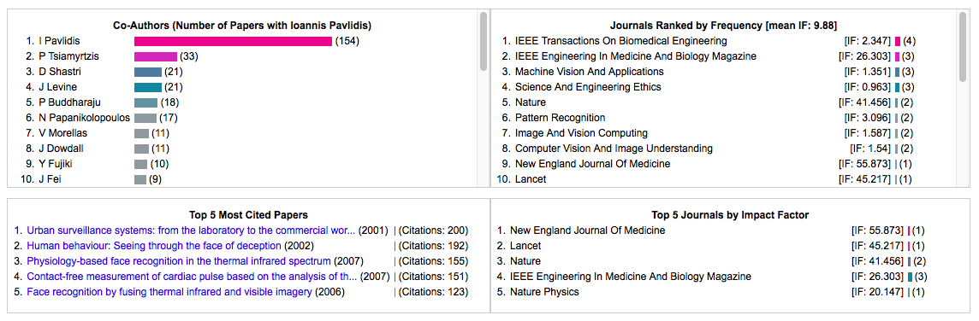
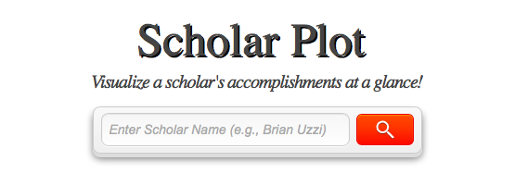
Conclusion
Scholar Plot, a visualization interface for academic merit.
Notes:
We presented Scholar Plot (SP), a compact and scalable (individual-department-college) visualization interface for academic merit. We released SP at http:\scholarplot.com.
The basic idea behind SP is to facilitate instant deeper insights regarding different strengths of academic records, supporting the work of evaluation committees and the curious academic in search of an advisor or department. One of SP’s strengths is that it draws data from open sources that are inclusive.

Slide 39
Future Work
Individual
Comparison between two scholars regarding publications and funding
More agencies if available
Group
Interested in group level such as department level
Notes:
We also want to see the group Not only individual but also group such as department, college
JCR Impact Factor update – v.2015 (yearly released)
NSF update – v.2016 (quarterly released)
NIH update – v.2015 (yearly released)
More agencies
More usability survey and refine the product at top-level
What the plan to do
May 2016

Slide 40
PhD Timeline
Fall 2011
Started my PhD
Fall 2013
iPhone app
Graduation
Fall 2015
Fall 2012
User Portrait
Scholar Plot
Proposal
Fall 2014
ACM UbiComp
IEEE VIS
First Publication
GRaSP Poster Presentation
GRaSP Poster Presentation
Notes:
s

Slide 41
References
Introduction
http://www.sas.com/en_us/insights/big-data/data-visualization.html
Related Works
https://github.com/ckreibich/scholar.py
http://www.csullender.com/scholar/

Slide 42
Acknowledgments
Committees
Prof. Ioannis Pavlidis (Dept. of Computer Science at UH) – Advisor
Prof. Ricardo Vilalta (Dept. of Computer Science at UH)
Prof. Zhigang Deng (Dept. of Computer Science at UH)
Prof. Guoning Chen (Dept. of Computer Science at UH)
Prof. Brian Uzzi (Northwestern University) – External
All our CPL members
Notes:
Management & Organizations

Slide 43
Thank you!
?

Slide 44
Departmental Plot

